Slide 1
International Institutions and the Rise of European Nationalism
Austin Humphrey

Slide 2

Agenda
Analyzing Brexit & the Future of the EU
  Key Terms
  Research Questions
  What is Brexit?
  Leave vs. Remain: A Divided Kingdom
  International Institutions & Trade Blocs
  Rise of the Far-Right
  Conclusion: Predicting the Future

Slide 3
Key Terms
Liberalism: belief that states can work together to maximize prosperity and minimize conflict
Trade Bloc: intergovernmental agreement where trade barriers are reduced or eliminated among member states (often regional)
Right-Wing Populism: political ideology combining far-right politics and populist rhetoric/themes (anti-elitist, opposition to system, voice of the “common people”)
Xenophobia: irrational dislike or fear of people from other countries

Slide 4
Driving Question
What measures can be taken to ensure continued peace and promote economic prosperity worldwide?
Notes:
ANSWER: LIBERALISM AND REGIONAL TRADE BLOCS

Slide 5
Research Questions
1
2
3
Will Brexit influence other EU member nations’ viewpoint on the validity of international institutions/trade blocs if successful?
Do the pros of globalization and regional free trade outweigh the cons?
Will the UK be able to retain noteworthy international influence without an attachment to the EU?

Slide 6
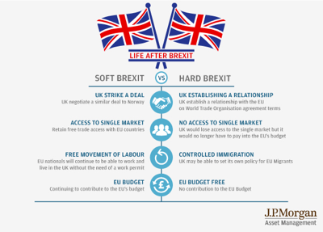
What is Brexit?
The prospective withdrawal of the UK from the EU
2016 Referendum: (per BBC)
  72.2% turnout (46,501,241 total voters)
  51.9% voted “Leave”; 48.1% “Remain”
Extent of consequences hinge on “Hard” vs. “Soft” Brexit

Slide 7
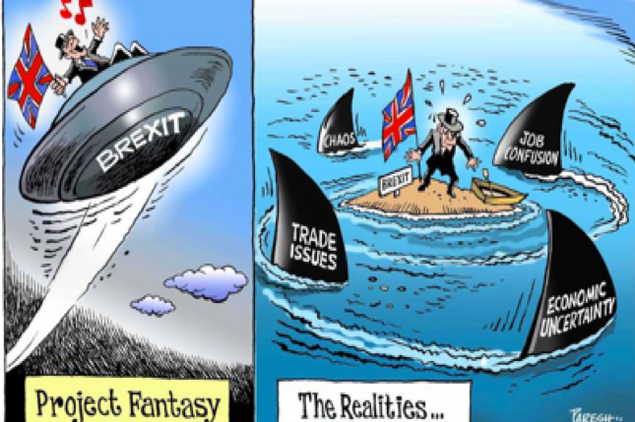
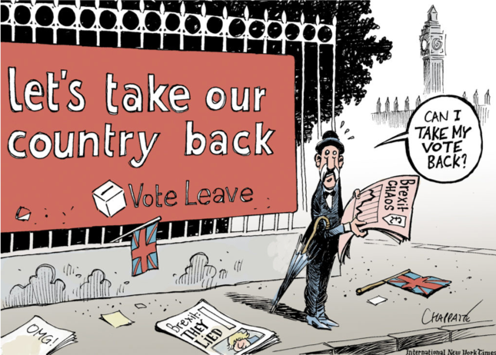
What is Brexit?

Slide 8
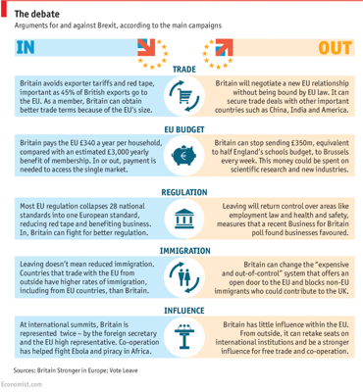
Leave vs. Remain: A Divided Kingdom
Key Issues:
  Immigration
  The Economy
  Sovereignty
“Remain” side claims “Leave” voters are uninformed
UK claims “hard-break” will be sought

Slide 9
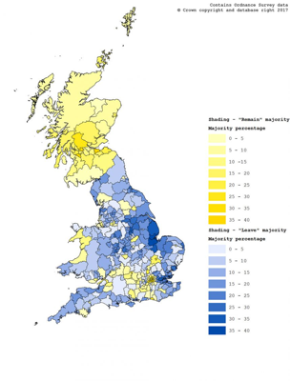
Leave vs. Remain: A Divided Kingdom
Scotland, Northern Ireland voted “Remain”
England, Wales voted “Leave”
Urban areas largely support “Remain,” rural “Leave”
  Education/income gap?

Slide 10
International Institutions & Trade Blocs
International Institutions Facilitate Trade Blocs
Single Market
Advantages of Trade Blocs
  Trade Blocs = Greater Economic Prosperity
  Regional Free Trade 🡪 Specialization (EU nations similar to states in US)
  Job opportunities
  Production costs
  Consumer prices
  Labor quality
  Competition and trade
  Competition
  Economies of scale
  Foreign direct investment (FDI)
  Market efficiency
  Trade effects (no tariffs)

Slide 11
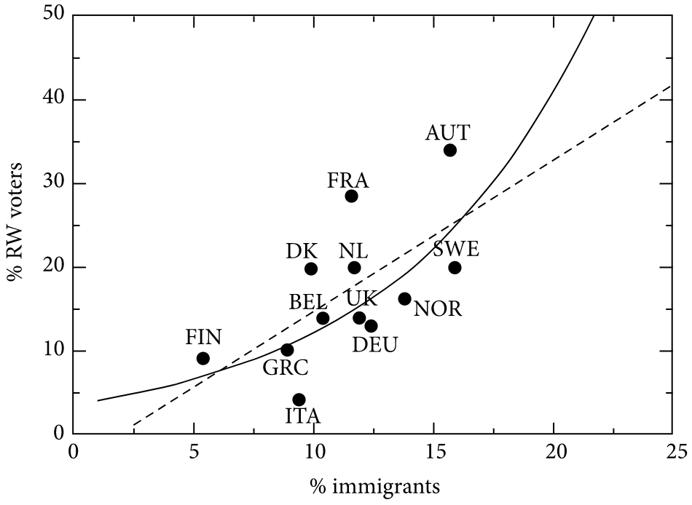
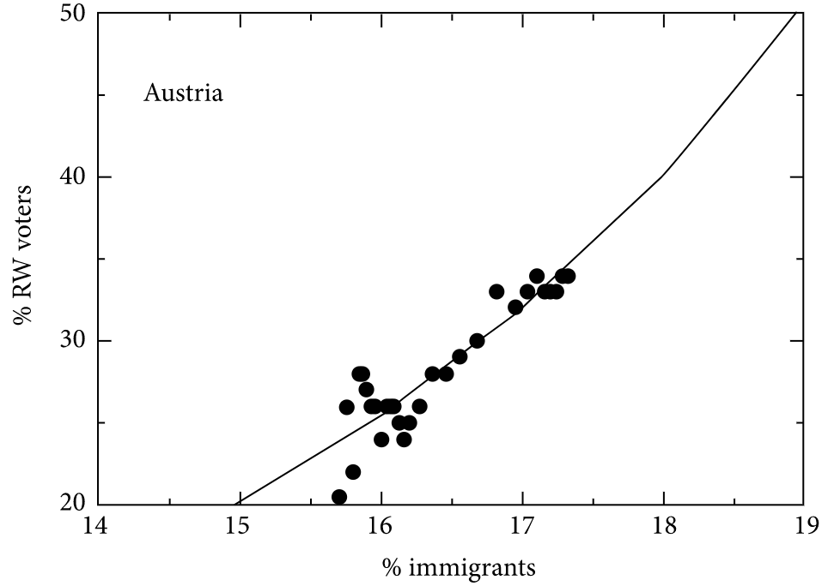
Rise of the Far-Right
Causes for Trend: (via Bloomberg)
  Corrupt elites
  Fading manufacturing sector
  Increasing income inequality
  National sovereignty
  Uncontrolled immigration
Xenophobia Key Driver
  Poll: 73% Brexit “Leave” voters cite immigration as main reason (Independent)
Larger # of Immigrants = Greater % of Population RW Populist
RW = Right-Wing

Slide 12
Rise of the Far-Right
Most prevalent in:
~10% of popular vote in most Western states
Surprisingly, UK seen recent dip in popularity
Eastern Europe
Excluding Belgium, western France/Germany
2015: 12.6%🡪 2017: < 2%
Scandinavia

Slide 13
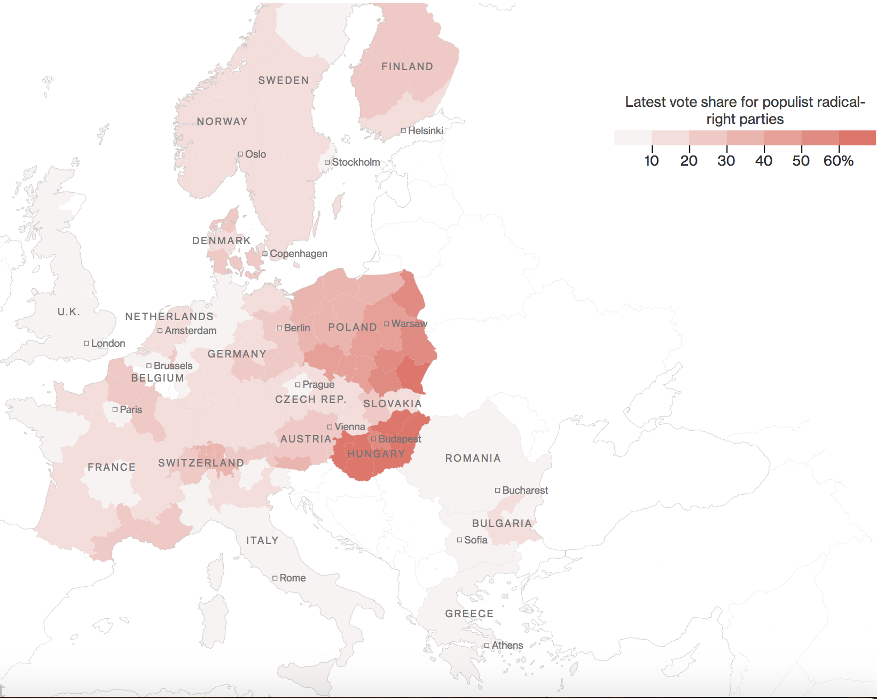
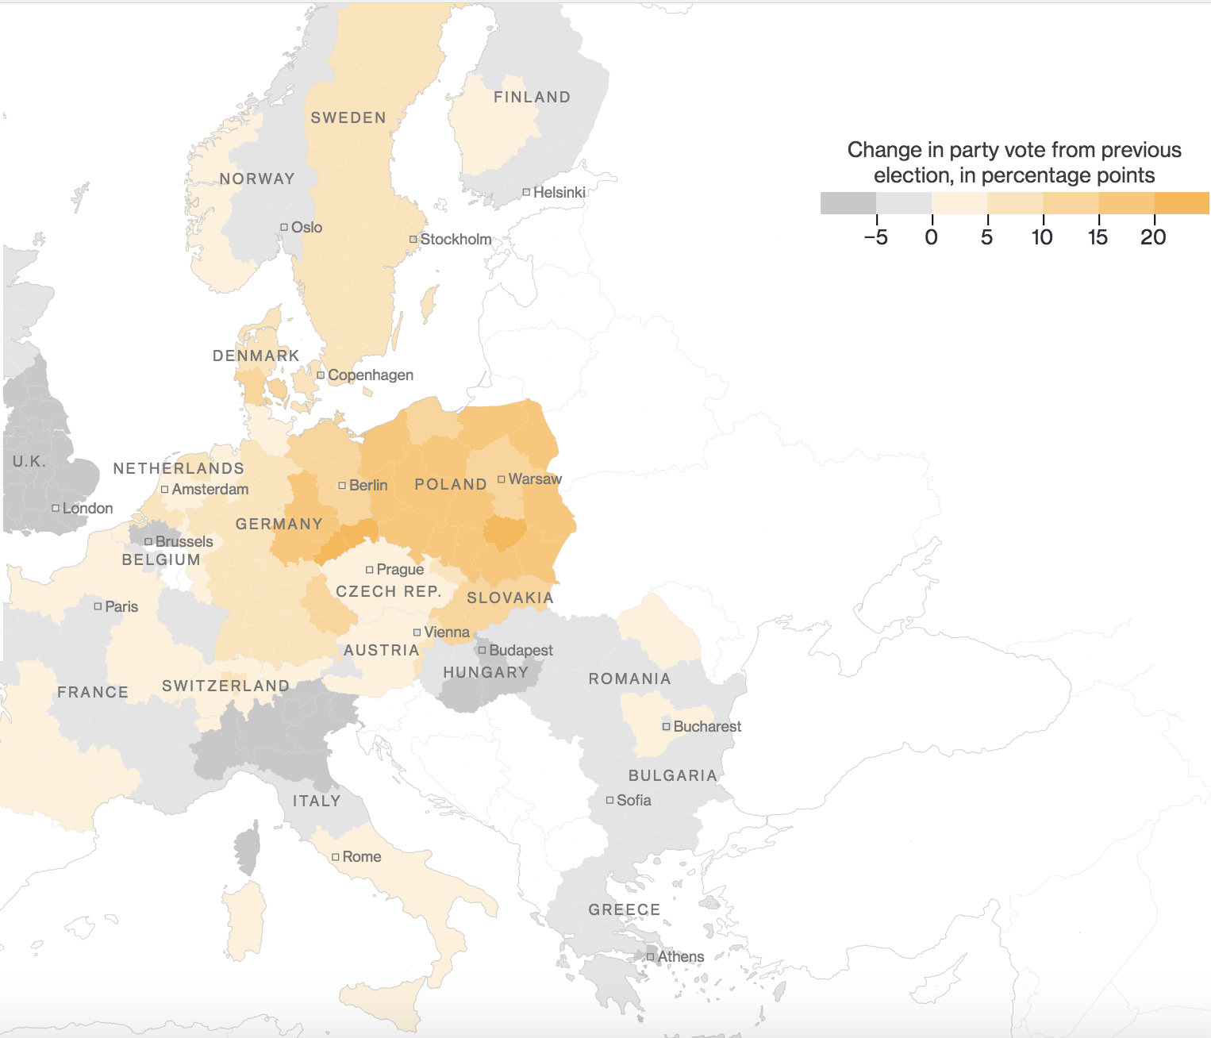
Rise of the Far-Right

Slide 14
Conclusion: Predicting the Future
What’s in store for the UK and EU will only unravel with time. First off, this is because the two sides don’t finish hashing out the finals details of the break until the transition period ends in 2020. After an agreement is reached, the true test for both will come. If the UK succeeds independent of the EU, other member nations will likely gain confidence that they too can survive alone. This would lead to a reexamination of the very utility of international institutions and trade blocs, meaning not only the end of the EU, but also the years of progress made towards globalization and free trade.

Slide 15
Questions?

Slide 16
Bibliography
Hanson, Dan. YouTube / A Quick Guide to the Economic Arguments of the Brexit Debate, Bloomberg / YouTube, 21 June 2016, www.youtube.com/watch?v=ACGD30AS1V8.
“EU Referendum Results.” BBC News, BBC, www.bbc.com/news/politics/eu_referendum/results.
“Mapping the Brexit vote.” University of Oxford, University of Oxford, 7 Mar. 2017, www.ox.ac.uk/news- and-events/oxford-and-brexit/brexit-analysis/mapping- brexit-vote.
Podobnik, Boris, et al. “Predicting the Rise of EU Right-Wing Populism in Response to Unbalanced Immigration.” Complexity, Edited by Fabio Caccioli, vol. 2017, 7 Aug. 2017. Complexity, Portico, doi:https://doi.org/10.1155/2017/1580526.
Bulman, May. “Brexit: People Voted to Leave EU Because They Feared Immigration, Major Survey Finds.” The Independent, Independent Digital News and Media, 28 June 2017, www.independent.co.uk/news/uk/home-news/brexit-latest-news-leave-eu-immigration- main-reason-european-union-survey-a7811651.html.

Slide 17
Bibliography (Cont.)
Dryden, Alex. “Life after Brexit: ‘Soft Brexit’ or a ‘Hard Brexit’?” The UK Edge, Centaur Media (Fund Strategy and Money Marketing) and J.P. Morgan Asset Management, 12 Apr. 2017, uk- edge.centaur.jpmorgan.com/users/15606-alex-dryden/posts/10479-life-after-brexit-soft- brexit-or-a-hard-brexit.
Barbari, Matthew. “UK Referendum: Could Britain Leave the EU?” Foreign Policy Blogs, Foreign Policy Association, 25 Mar. 2016, foreignpolicyblogs.com/2016/03/25/uk-referendum- britain-leave- eu/.
Tartar, Andre. “How the Populist Right Is Redrawing the Map of Europe.” Bloomberg.com, Bloomberg, 11 Dec. 2017, www.bloomberg.com/graphics/2017-europe-populist-right/.
“Trade Agreements.” RoCETA, The College at Brockport, roceta.org/trade-agreements.

